Slide 1
software architecture
Software Architecture consists of word software and architecture. First, we must understand the definition of these two words, software, and architecture.
A computer program or software is a collection of computer instruction or compilation of information that tells the computer how to work and execute task or activities.
In computer science or software engineering, computer software is all information processed by computer systems, programs, and data.
Computer software includes computer programs, libraries, patches, and related non-executable data, such as online documentation or digital media. Computer hardware and software need each other, and they cannot be used separately.

Slide 2
Software Architecture typically refers to the bigger structures of a software system, and it deals with how multiple software processes cooperate to carry out their tasks.
Software Design refers to the smaller structures and it deals with the internal design of a single software process.
The architecture of a system describes its major components, their relationships (structures), and how they interact with each other.
Software architecture and design includes several contributory factors such as Business strategy, quality attributes, human dynamics, design, and IT environment.
We can segregate Software Architecture and Design into two distinct phases:
Software Architecture and Software Design.

Slide 3
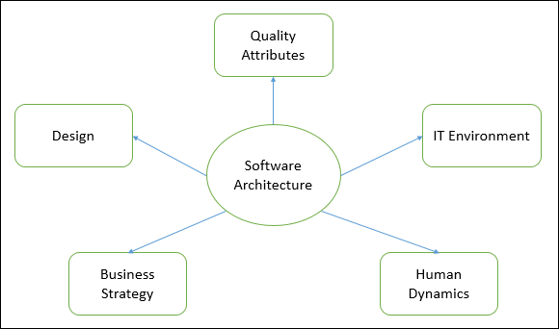

Slide 4
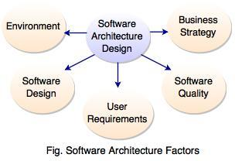
What is Software Architecture Design?
Software architecture design is a representation of system which aids in the understanding of how the system will behave.
It is a structured framework used to conceptualize software elements, relationships and properties.
It serves as the blueprint(design) for both the system and project.
Software architecture is used for defining and structuring of a solution which connects technical and operational requirements.

Slide 5
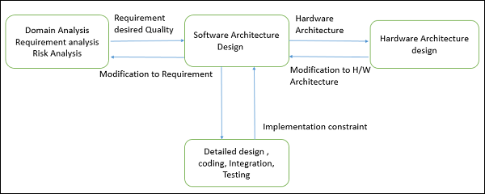

Slide 6
Why is Software Architecture Design important?
A software should be designed with consideration for the user, system and the business goals.
Software architecture considers a design for software to implement its structure according to its rules and requirements.
Software architecture manifests the earlier design decisions governing the system to be built and can be analyzed.
Software architecture considers the communication among stakeholders for mutual understanding, negotiation and agreement.
Software architecture constitutes transferable abstraction of a system and can promote large scale reuse.
It provides a common language in which different concerns can be expressed.
Software architecture focuses on how the major elements and components within an application are used or interacted within the application.

Slide 7
Goals of Software Architecture Design
Software architecture design improves the common quality attributes such as performance, security and manageability. Good design and architecture reduces the business risks and is flexible to handle the changes which occur over time in hardware and software technology.
Software Architecture Design has following goals:
The main important goal of software architecture design is to build the bridge between business and technical requirements.
To identify the requirements which affect the basic structure of the application.
Consider the overall effect of design decisions.
Design should be flexible to handle the changes in user scenarios and requirements.
To find the different ways to implement the use cases in the software.

Slide 8
Software Architecture is a system to represent the collection of components that accomplish a specific function or set of functions.
There may be one or multiple components in the foundation of an architecture on which software can be built.
A software architecture helps to define and represent the component(s) and their relationship.
We can understand software architecture with an example.
Let’s consider to build a bungalow on a plain land there is a need for a civil engineer or architecture. He gathers different types of input from our side and prepares a floor plan on the paper.
If requirements are fulfilled then builder starts construction work. In the same way, a software architect prepare a plan of as per the requirement.
He draws a structure that meets all technical and operational requirements of the software. The developer team builds the software as per software architecture and deliver to the client.
Before going to explain the types of architecture firstly you need to understand the different layers which are the foundation of software architecture. There are four types of layer:

Slide 9
Presentation Layer: This layer is responsible to display the user interface and manage user interaction.
Application Layer: Application layer (also known as Business Layer) has all the business logic, rules and policies. The application layer is a bridge between the presentation layer and the data layer.
Data Layer: This layer is responsible for storing the data.
Service Layer: This layer is responsible to define and implement the service interface and the data contracts. Service layer communicates with the application layer

Slide 10
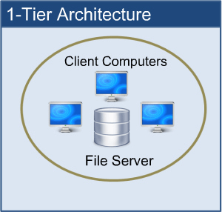
1. One-tier Architecture:
One-tier architecture has Presentation layer, Business layer and Data layers at the same tier i.e. at Client Tier. As the name suggested, all the layers and components are available on the same machine. MP3 player, MS Office etc. are some of the examples of one-tier architecture. To store the data (as a function of Data Layer) local system or a shared drive is used.

Slide 11
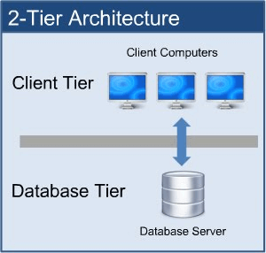
2. Two-tier Architecture:
In such type of architecture, the client tier handles both Presentation and Application layers and the server handles the Database layer. The two-tier architecture is also known as a ‘Client-Server Application’. In two-tier architecture, communication takes place between the Client and the Server. Client system sends the request to the server system and the server system processes the request and sends the response back to the client system.

Slide 12
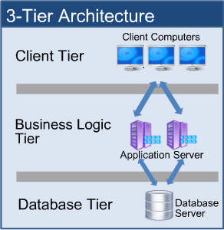
3. Three-tier Architecture:
All three major layers are separated from each other. Presentation layer resides at Client Tier, Application layer acts as middle-ware and lies at Business Tier and Data layer is available at Data Tier. This is a very common architecture.

Slide 13
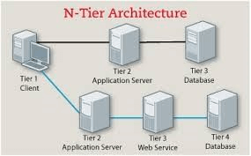
4. N-tier Architecture:
N-tier architecture is also called a Distributed Architecture or Multi-tier Architecture. It is similar to three-tier architecture but the number of the application server is increased and represented in individual tiers in order to distribute the business logic so that the logic can be distributed.

